Slide 1

Hospital
Management

Slide 2
Member of team
Tran Quang Huy
Guilded By
MR. CHANDRASEKHARA BARAT
MR. BALAKRISHNA PALLA
Tran Hung Trong

Slide 3
PROJECT INTRODUCTION
The hospitals to keep track of its day-to-day activities and records is necessary.
Keeping track of all the activities and their records on paper is very cumbersome and error prone.
“Hospital Management System” project aims at providing a paperless hospital.

Slide 4
1.1 PROJECT OBJECTIVES
Providing a paperless hospital
Computerizing all patient details & hospital details.
Low-cost and reliable management system

Slide 5





1.2 TECHNOLOGIES
JDK1.8
Eclipse IDE
Apache Tomcat 9.0.54
Oracle 11g
HTML, CSS, Java Script, JSP
Bootstrap
Spring Boot
Spring Data JPA dependency

Slide 6



1.3 PRODUCT FUNCTIONS
Doctor Management
Patient Management
Department Management

Slide 7



1.3 PRODUCT FUNCTIONS
Test Management
Test Form Management
Medicine Management

Slide 8



1.3 PRODUCT FUNCTIONS
Admission Form Management
Illness Management
Health Record Management

Slide 9
1.4 LIST OF MODULES
Admin:
Can access all function.
Doctor:
Cannot delete any data/resources
Create/view/update Patients.
Create/view/update Admission Form.
Create/view/update TestForm.
Create/view/update HealthRecord.

Slide 10
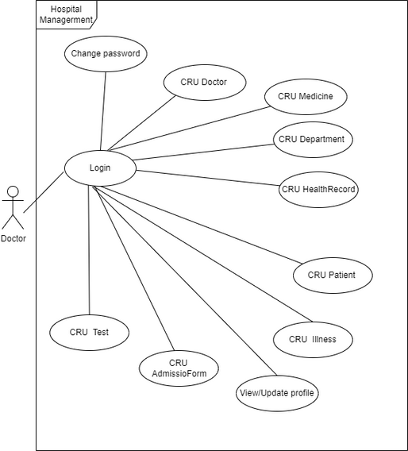
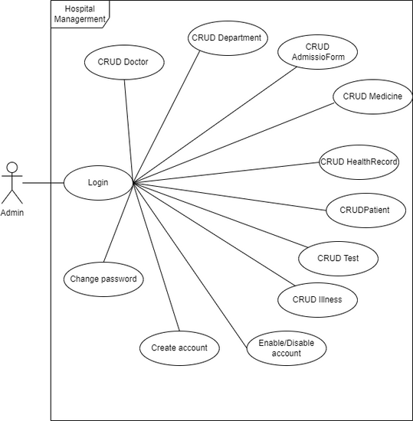
1.5 USE CASE DIAGRAM

Slide 11
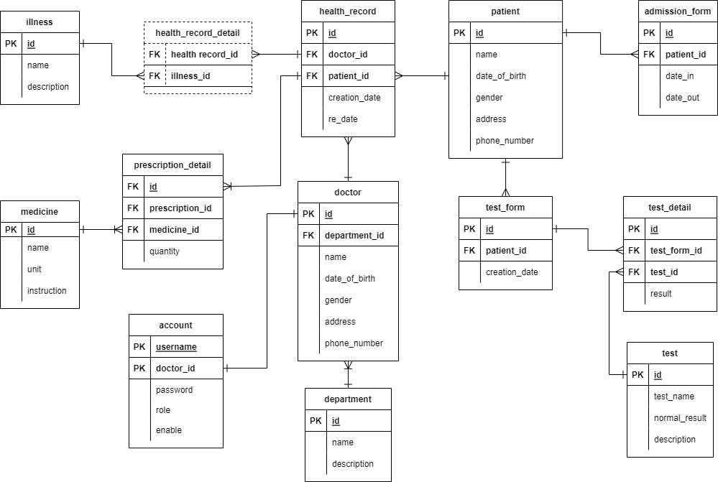
1.6 ERD

Slide 12
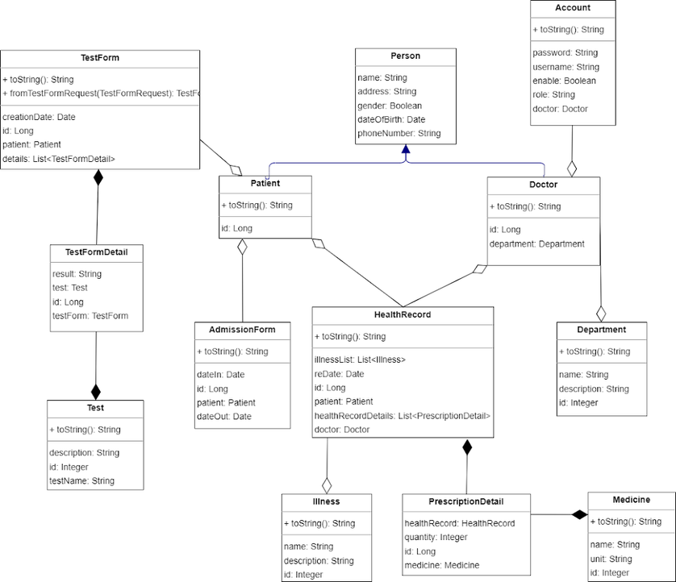
1.6 CLASS DIAGRAM

Slide 13
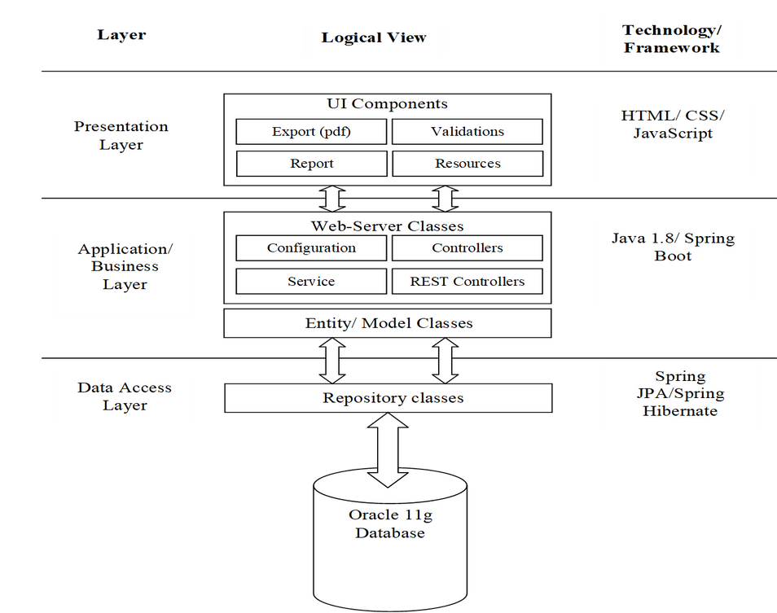
1.8 ARCHITECTURE
DIAGRAM

Slide 14
2. USER INTERFACE

Slide 15
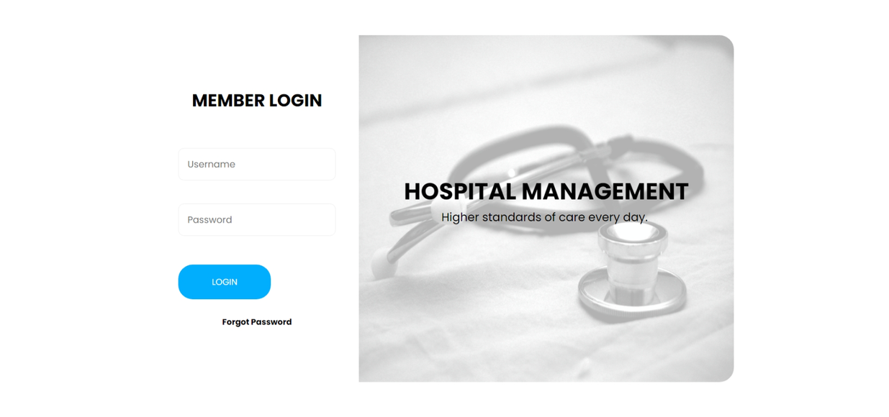
2.1 Login

Slide 16
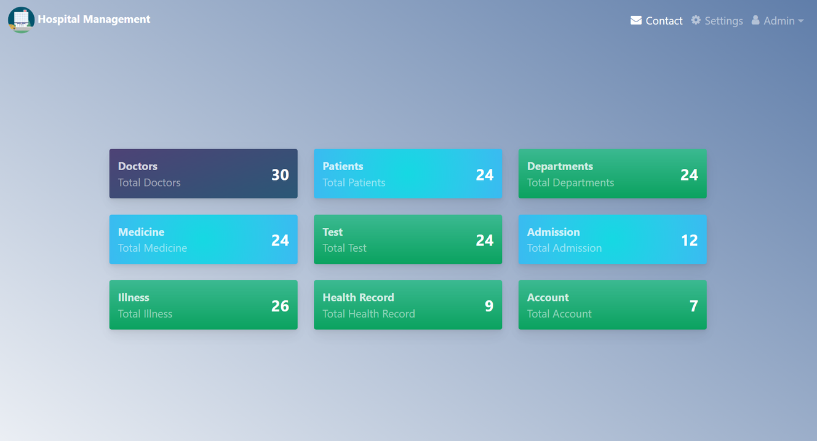
2.2 Dashboard

Slide 17
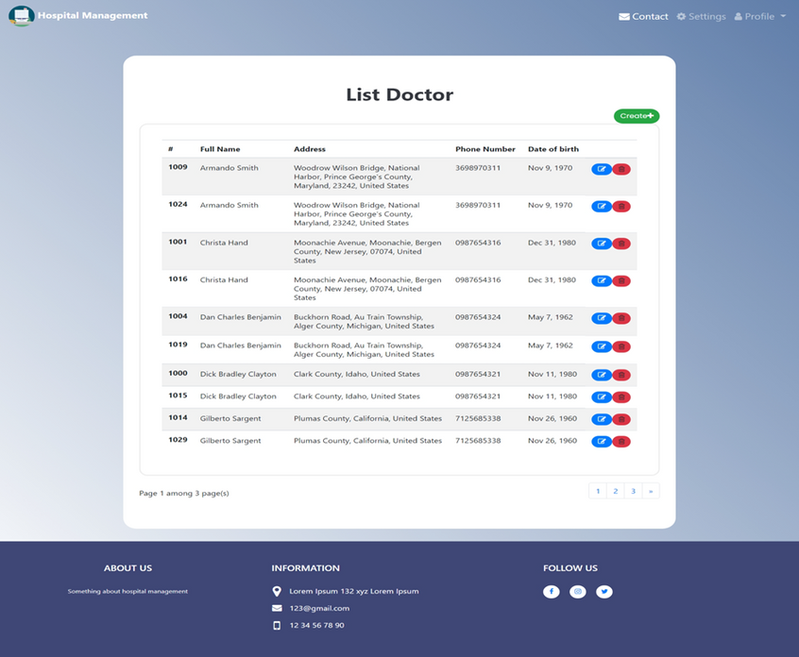
2.3.1 List Doctor

Slide 18
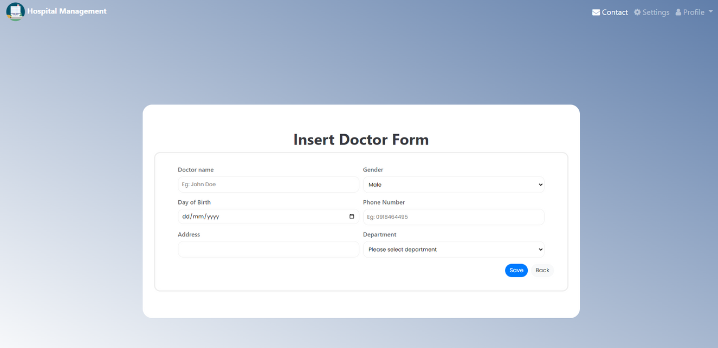
2.3.2 Create Doctor

Slide 19
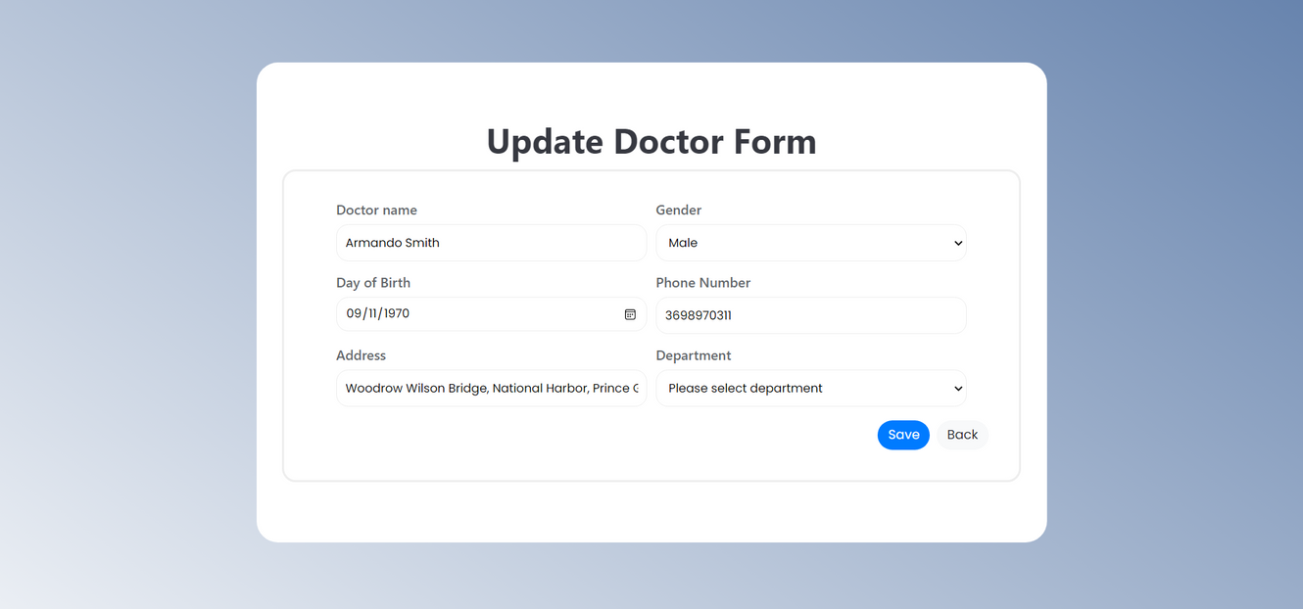
2.3.3 Update Doctor

Slide 20
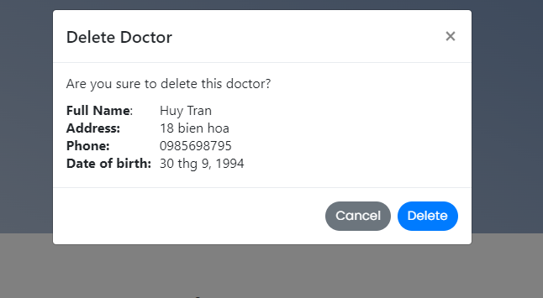
2.3.4 Doctor

Slide 21
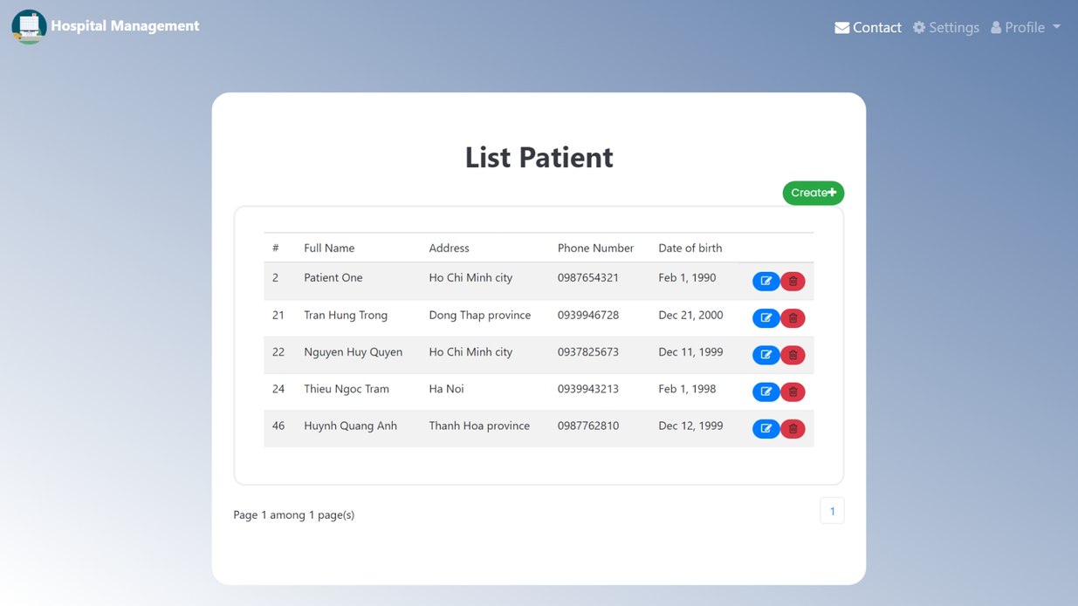
2.4.1 List Patient

Slide 22
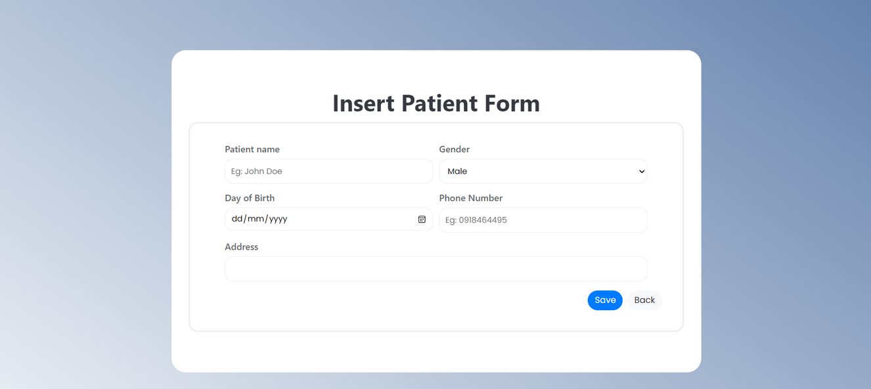
2.4.2 Insert Patient

Slide 23
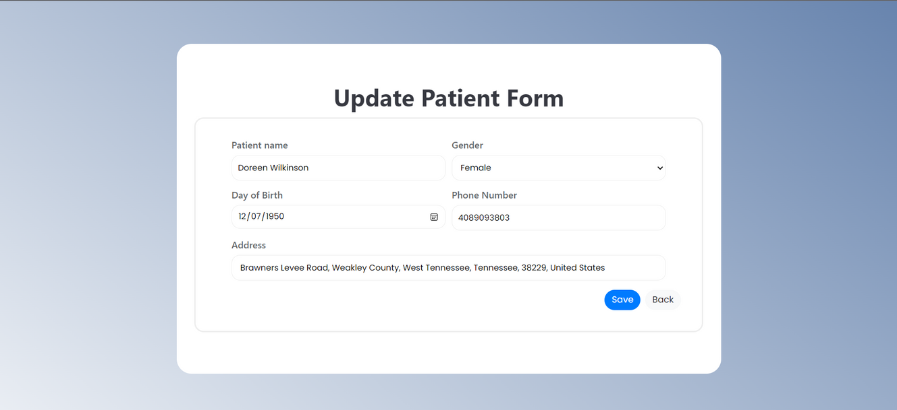
2.4.3 Update Patient

Slide 24
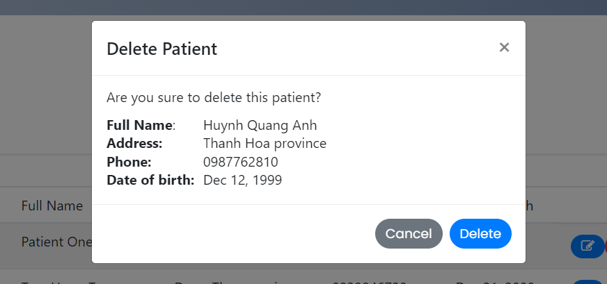
2.4.4 Delete Patient

Slide 25
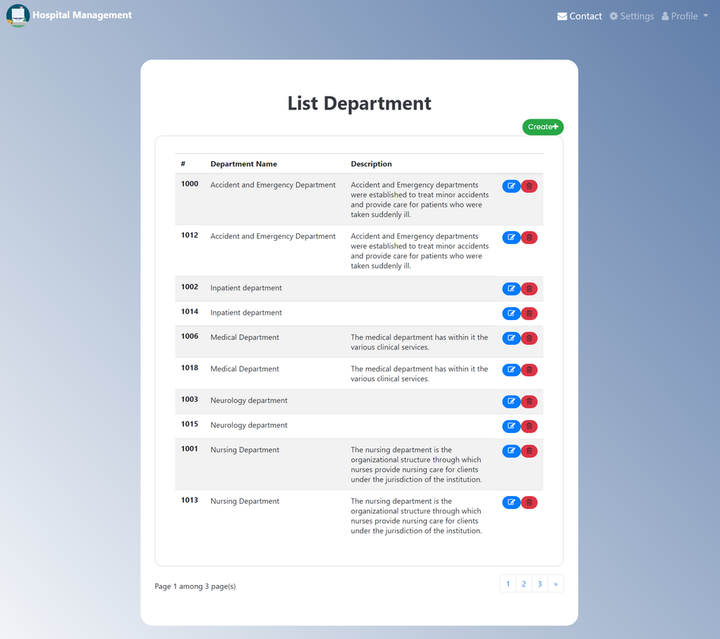
2.5.1 List Department

Slide 26
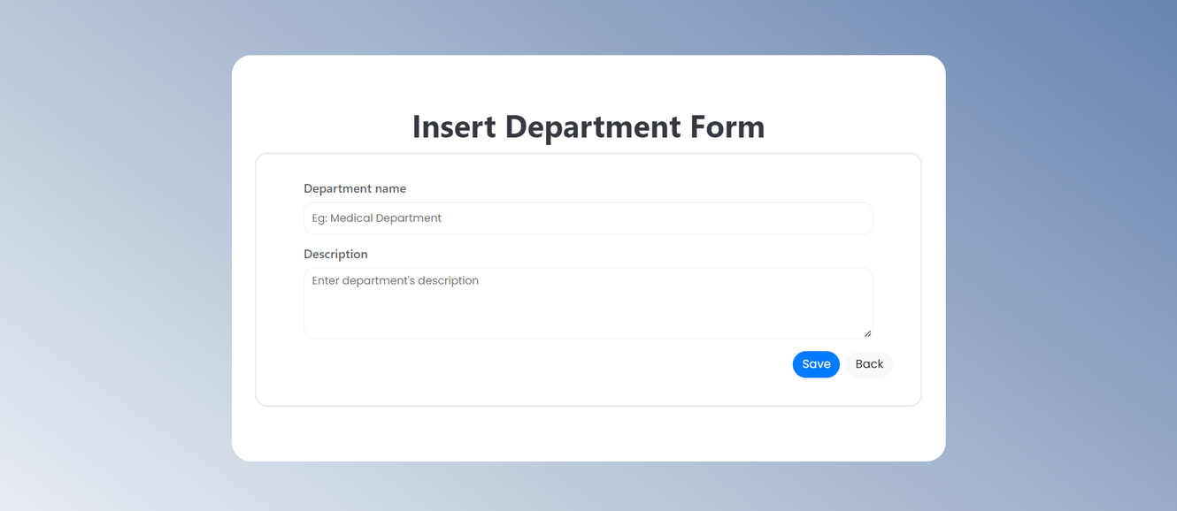
2.5.2 Insert Department

Slide 27
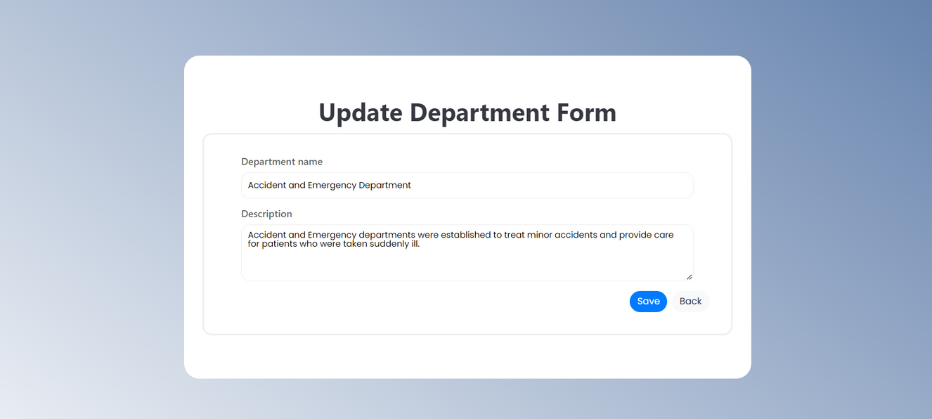
2.5.3 Update Department

Slide 28
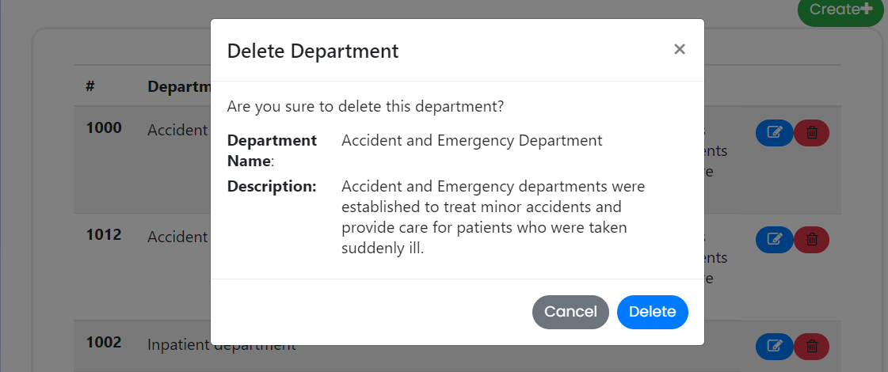
2.5.4 Delete Department

Slide 29
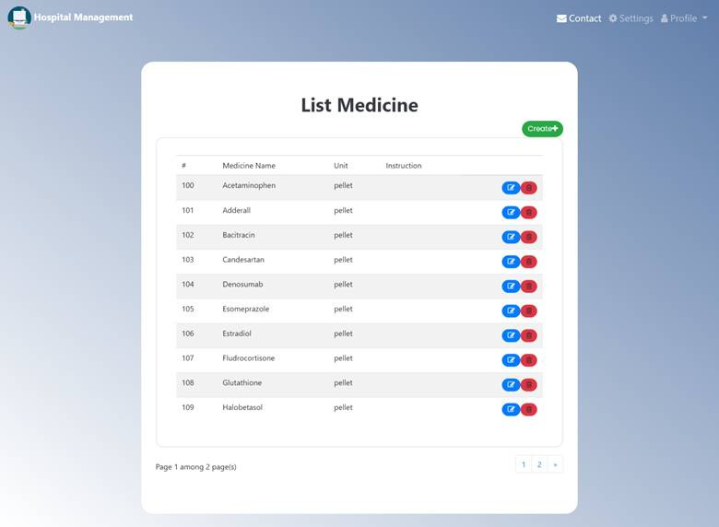
2.6.1 List Medicine

Slide 30
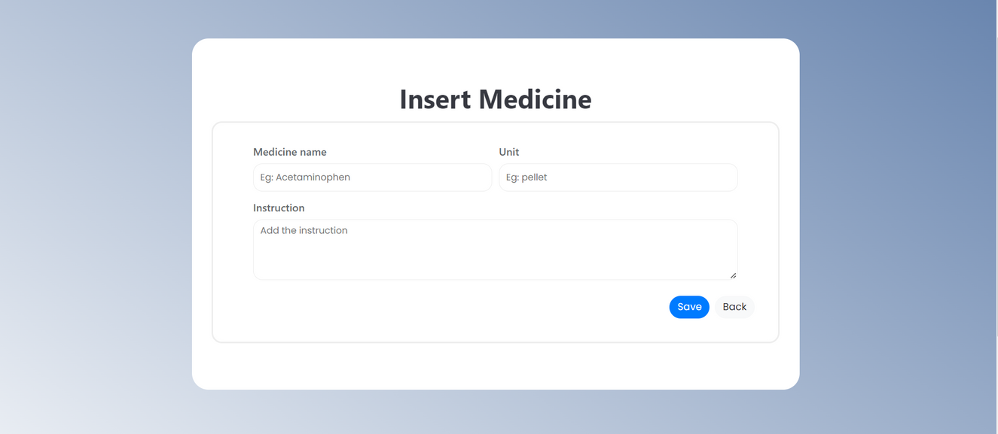
2.6.2 Insert Medicine

Slide 31
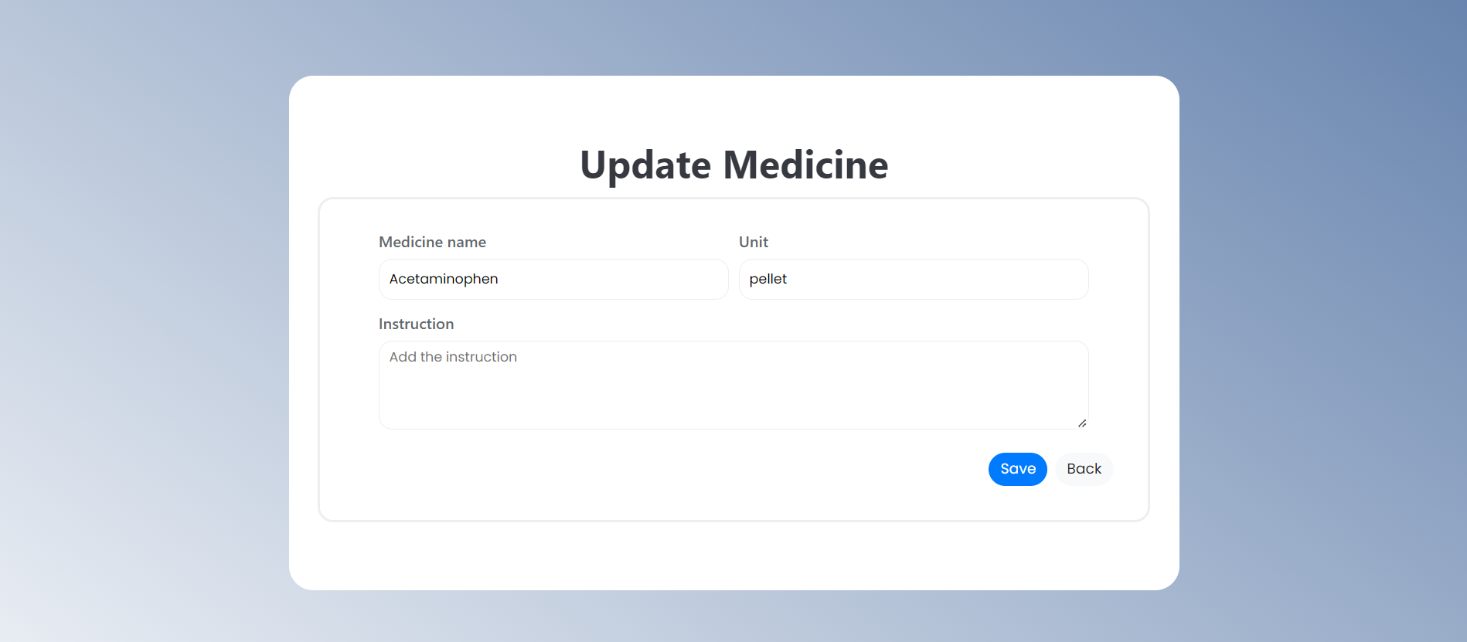
2.6.3 Update Medicine

Slide 32
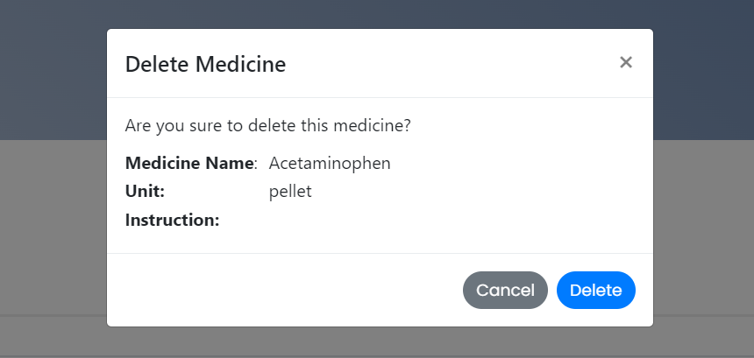
2.6.4 Delete Medicine

Slide 33
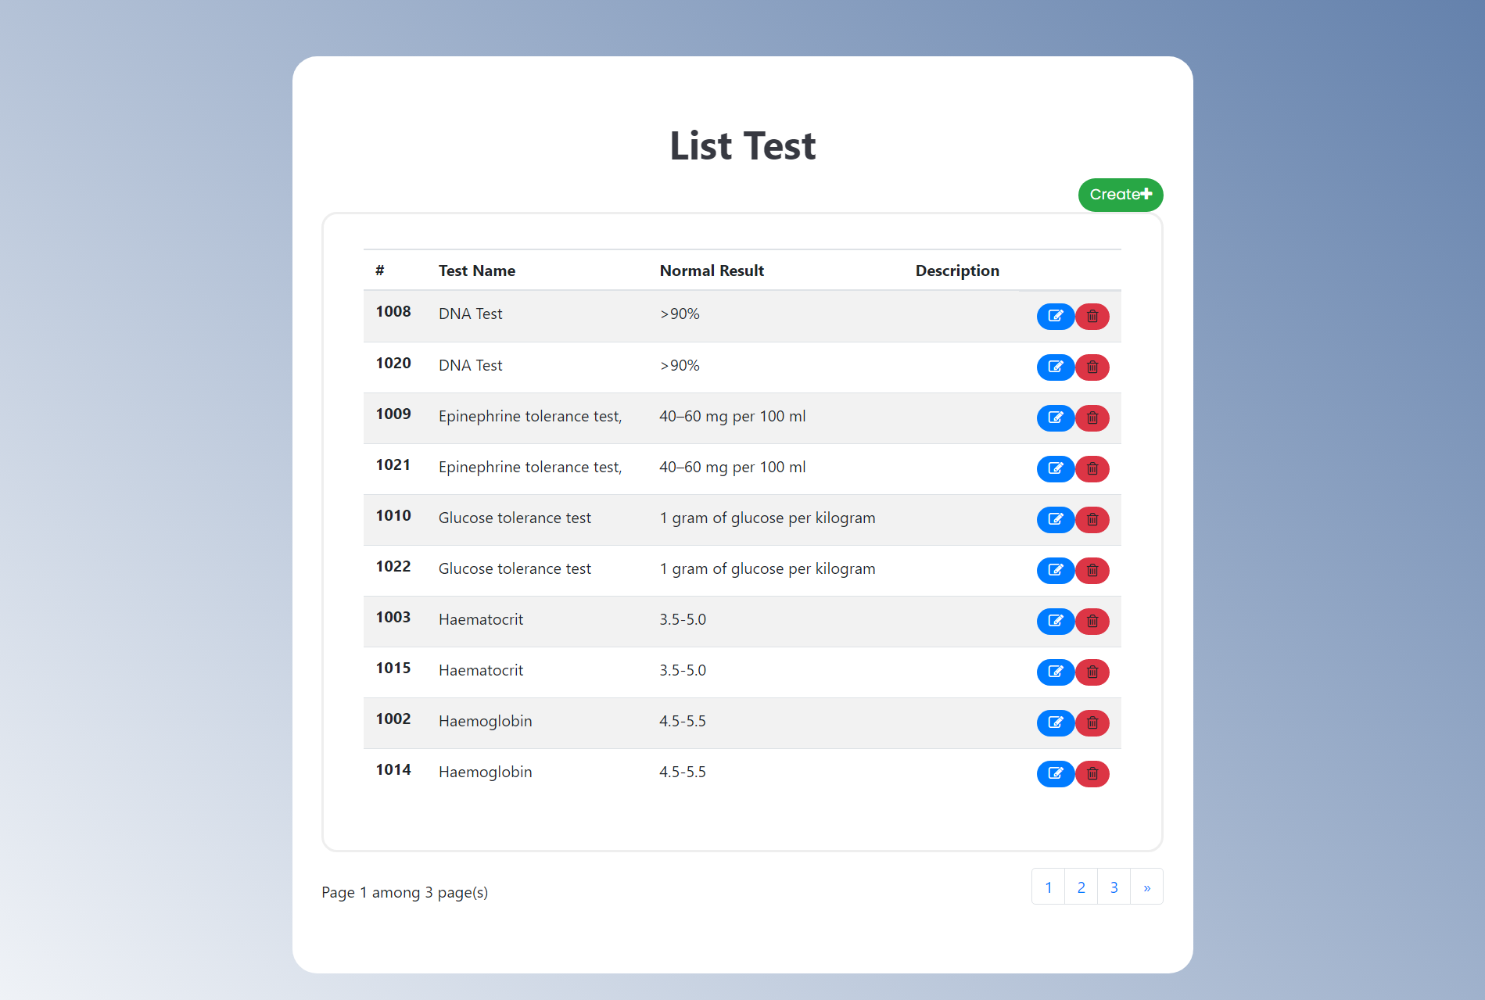
2.7.1 List Test

Slide 34
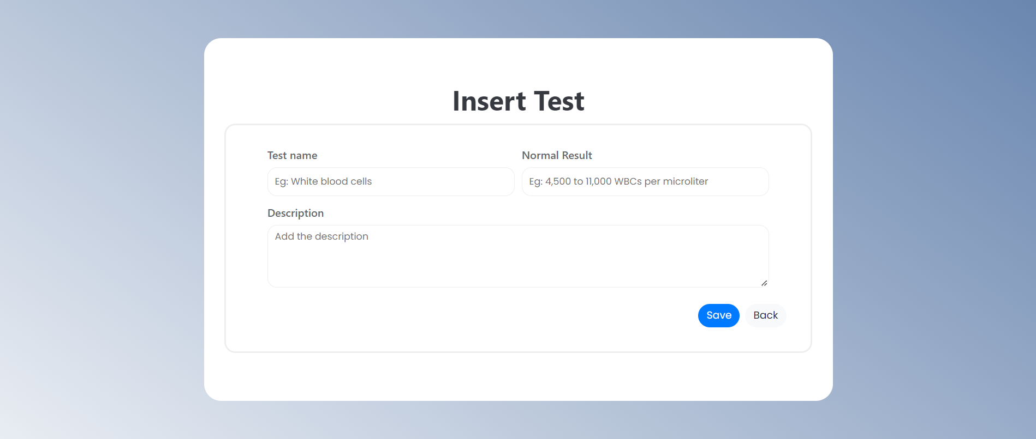
2.7.2 Create Test

Slide 35
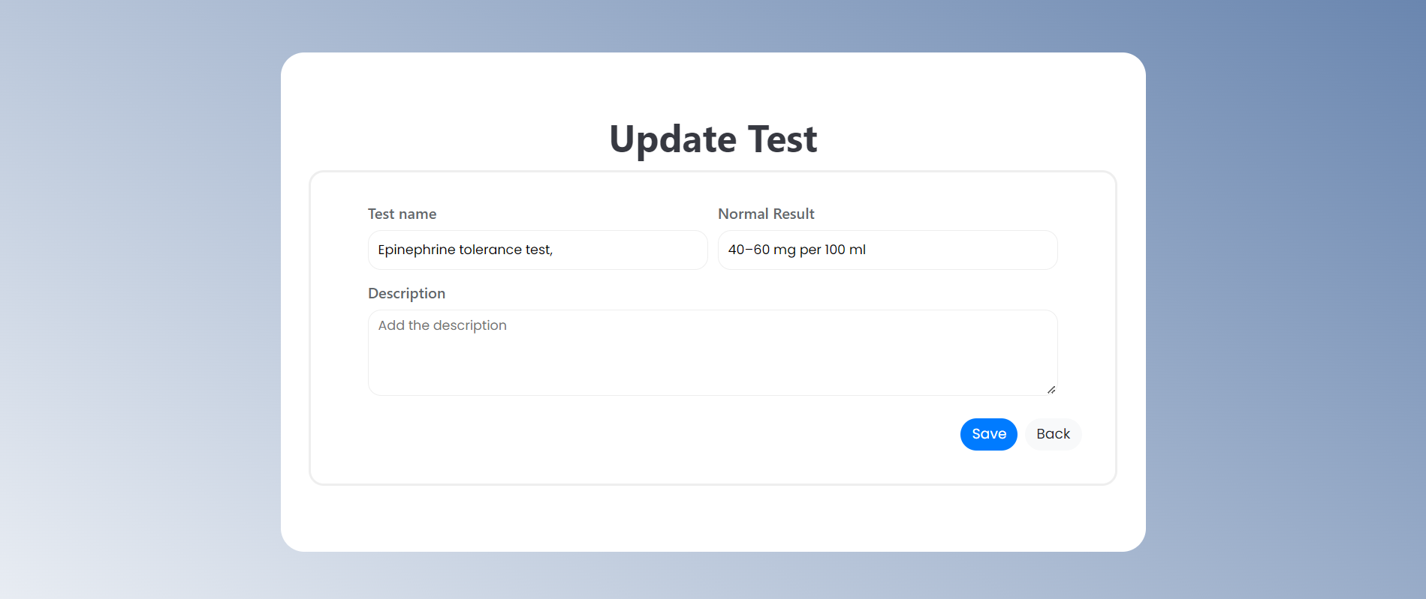
2.7.3 Update Test

Slide 36
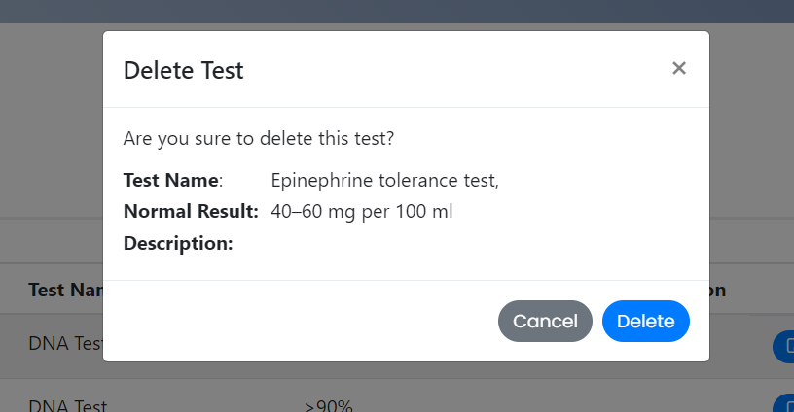
2.7.4 Delete Test

Slide 37
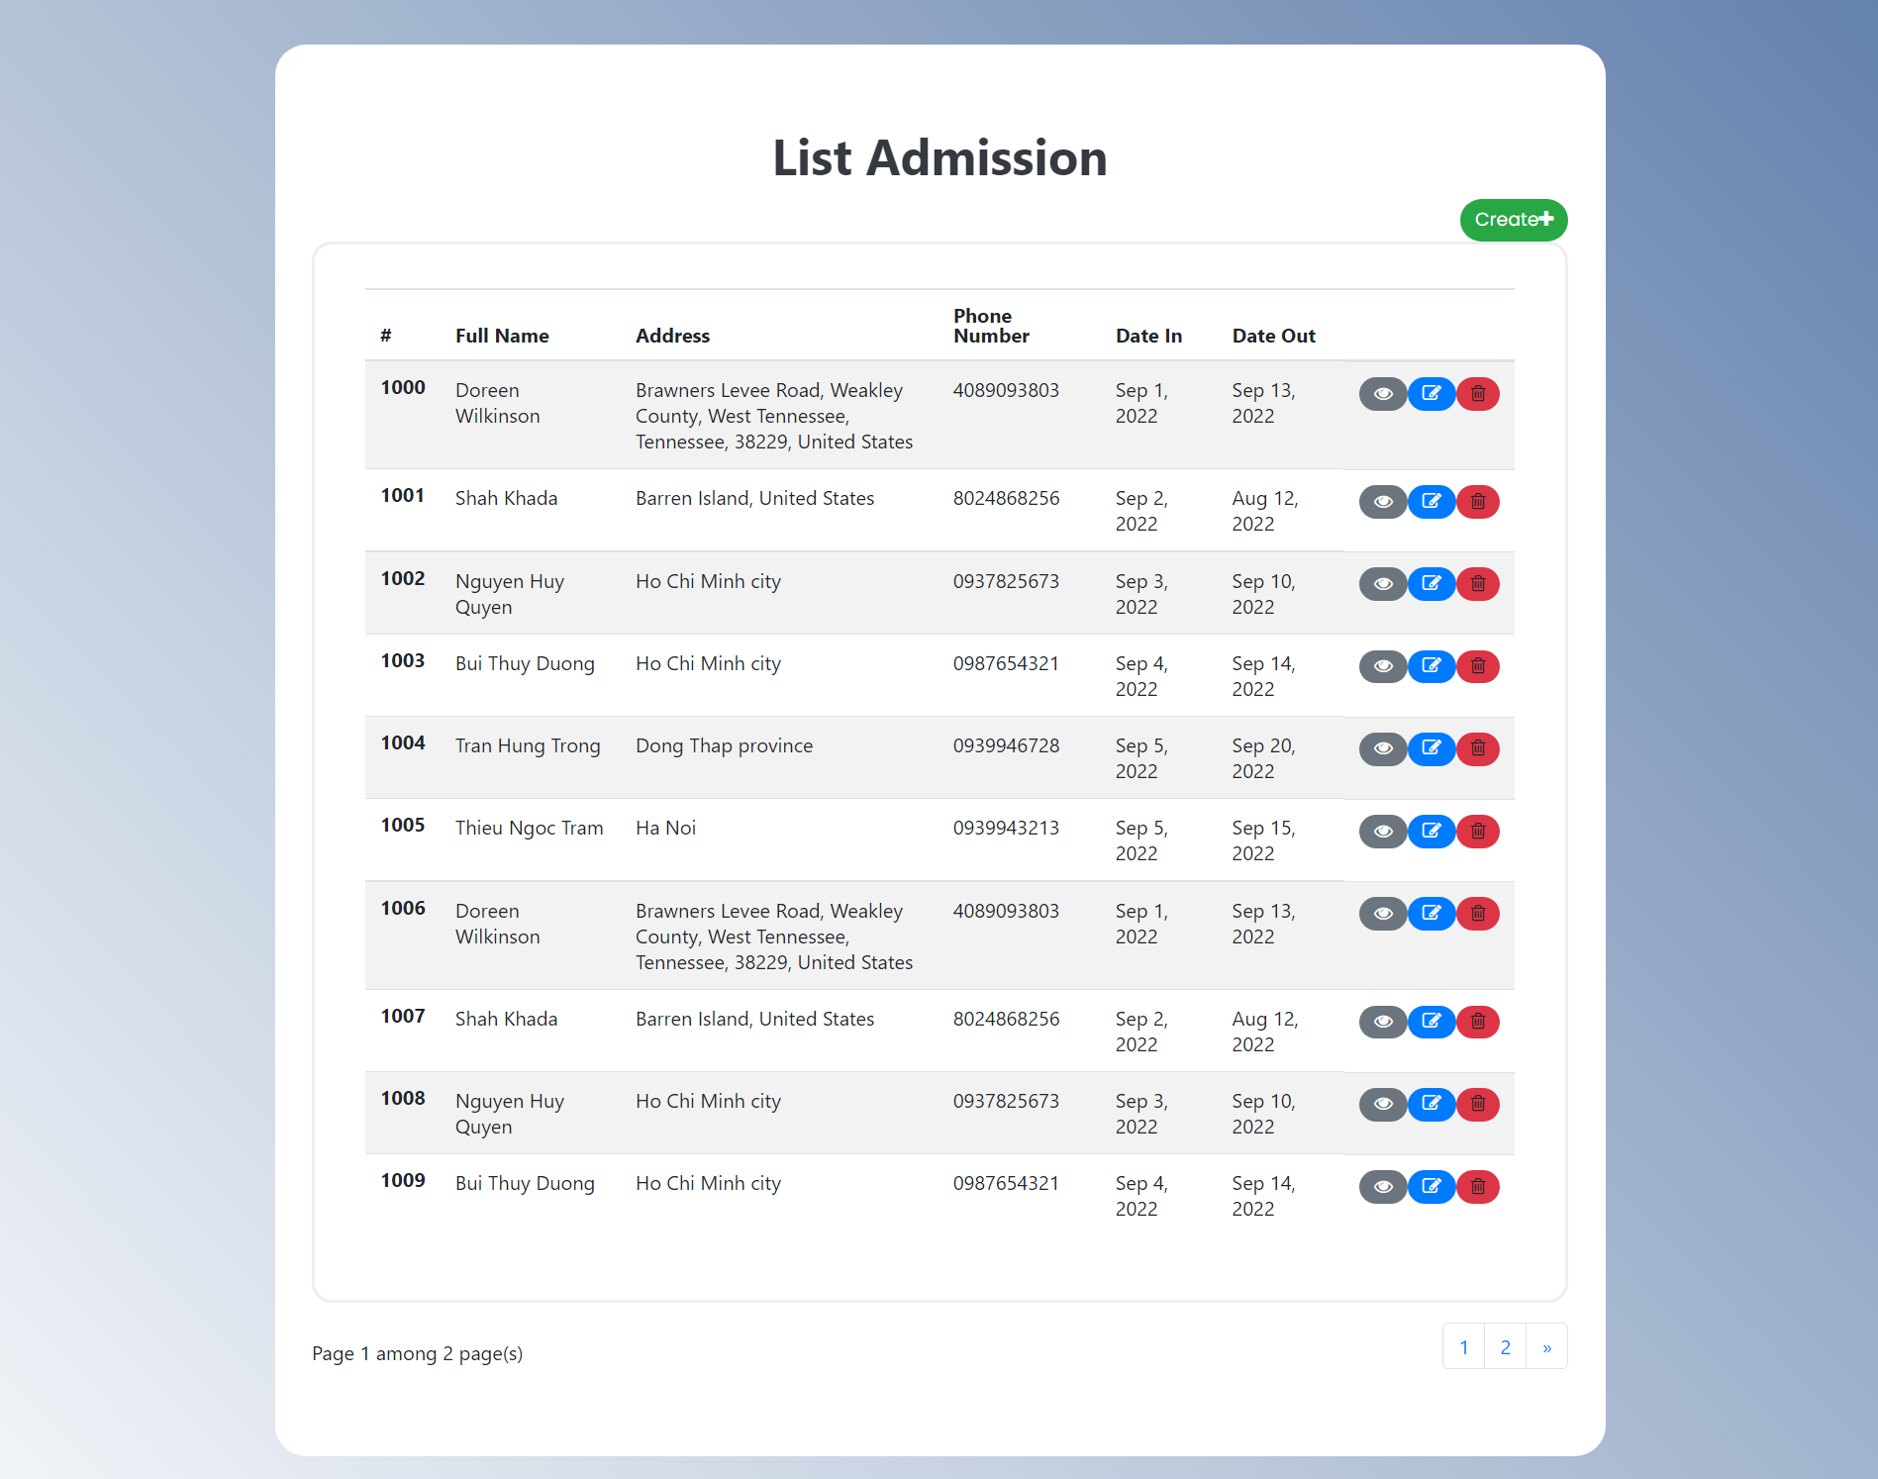
2.8.1 List
Admissison
Form

Slide 38
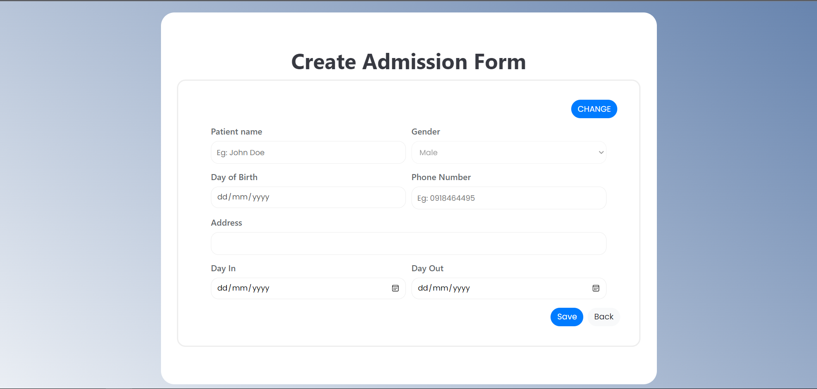
2.8.2 Create Admissison Form

Slide 39
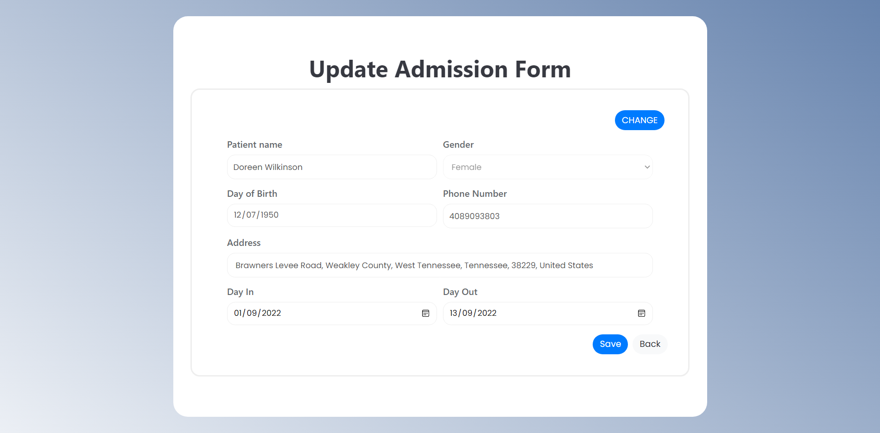
2.8.3 Update Admissison Form

Slide 40
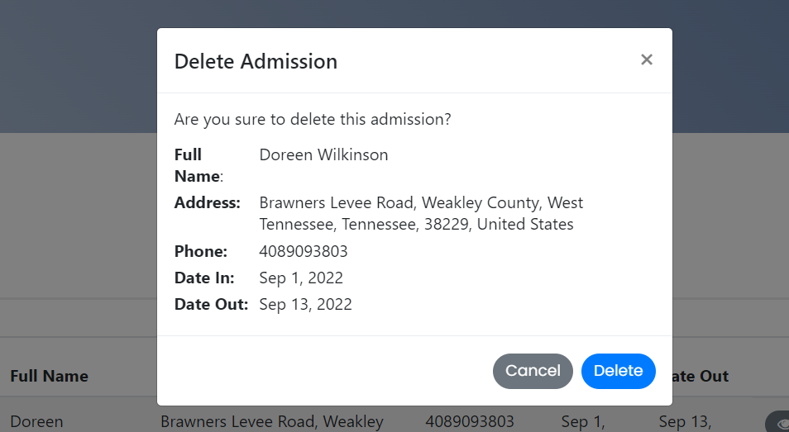
2.8.4 Delete Admissison Form

Slide 41
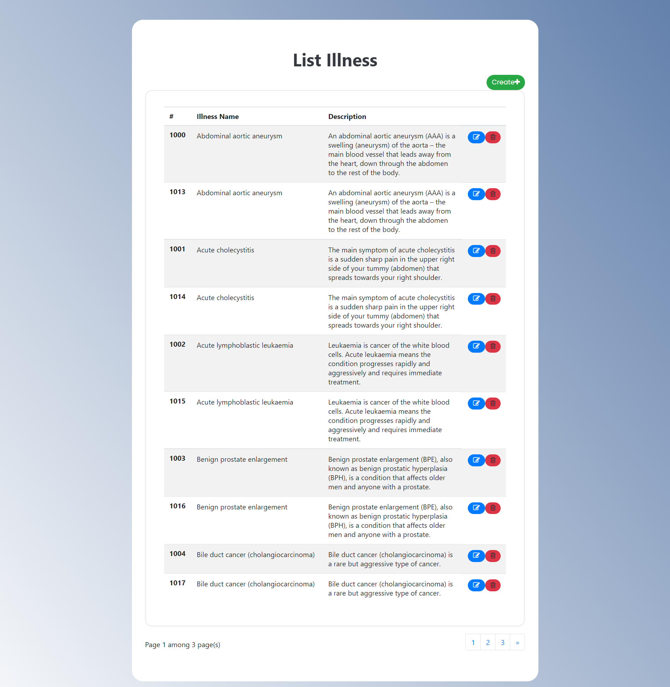
2.9.1 List Illness

Slide 42
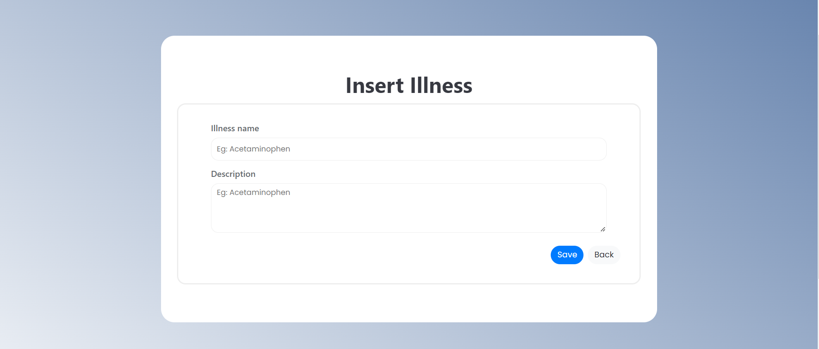
2.9.2 Create Illness

Slide 43
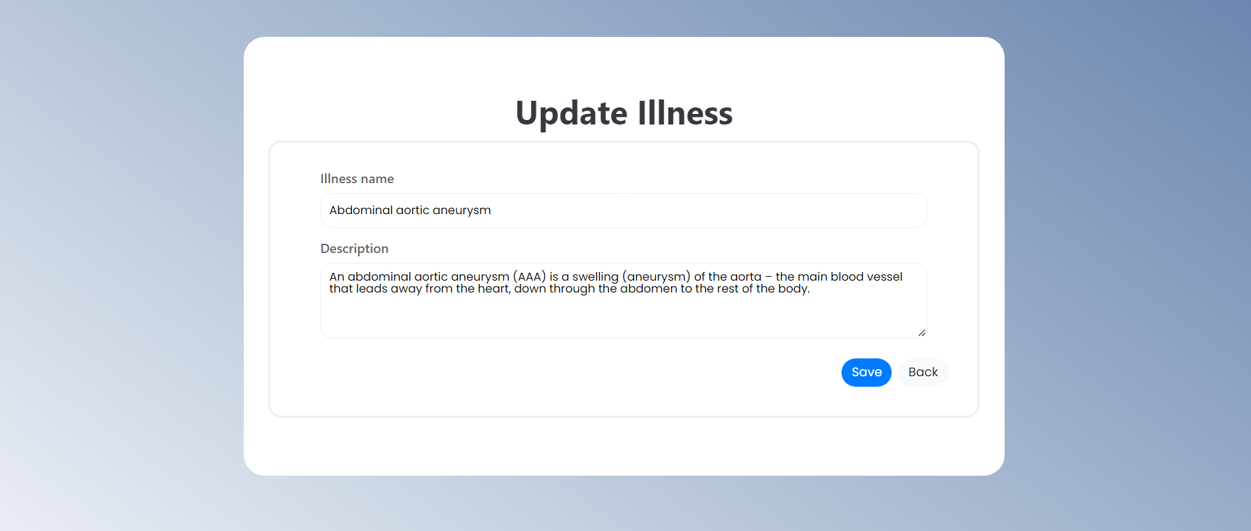
2.9.3 Update Illness

Slide 44
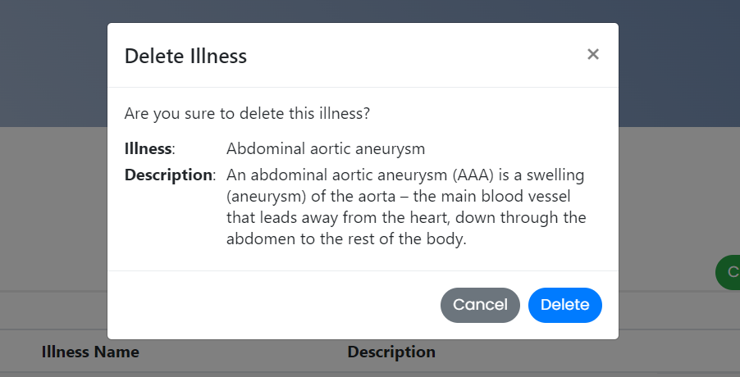
2.9.4 Delete Illness

Slide 45
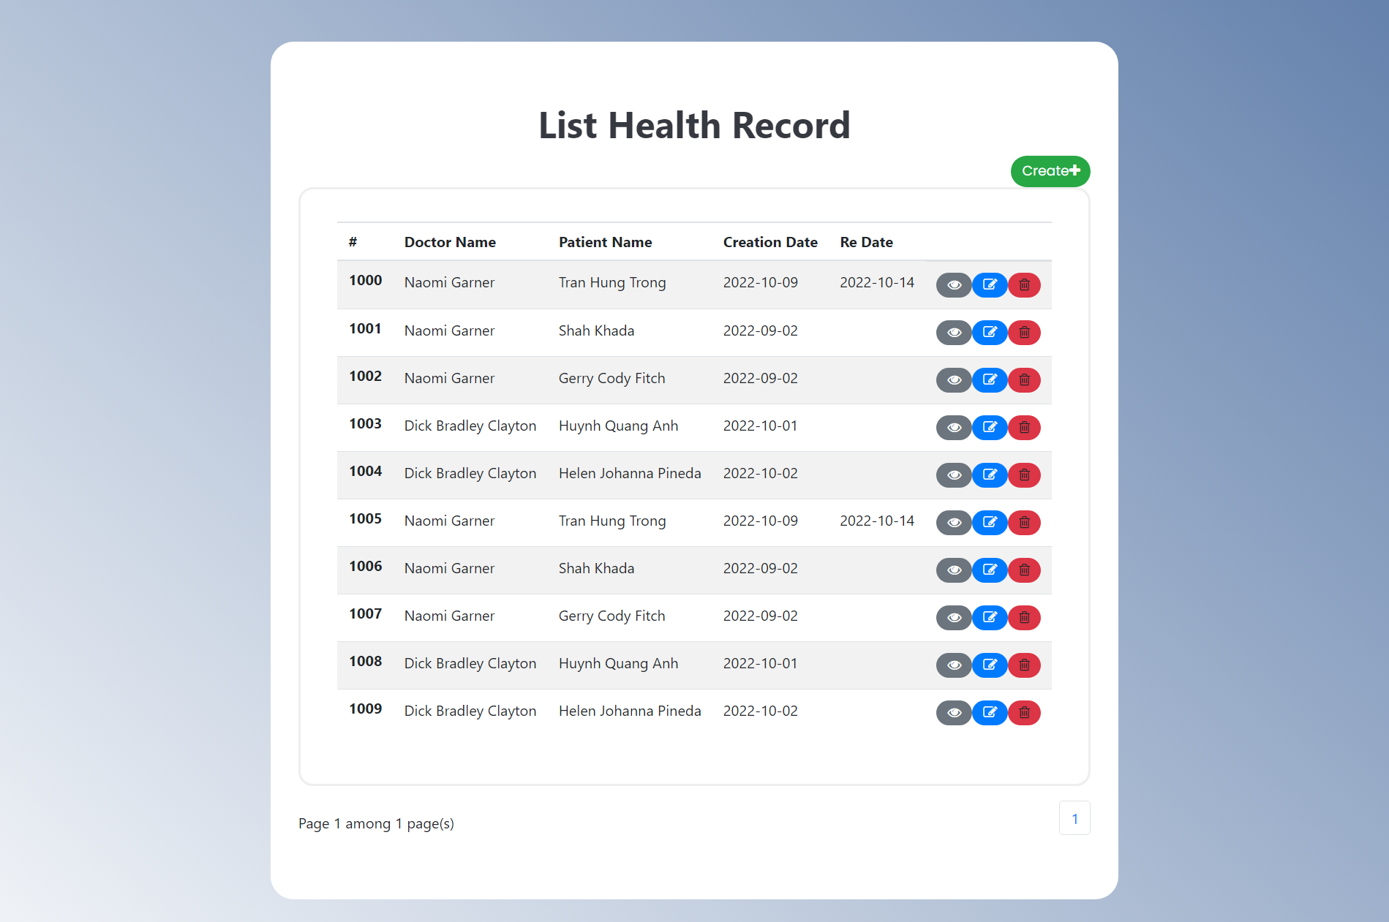
2.10.1 List Health Record

Slide 46
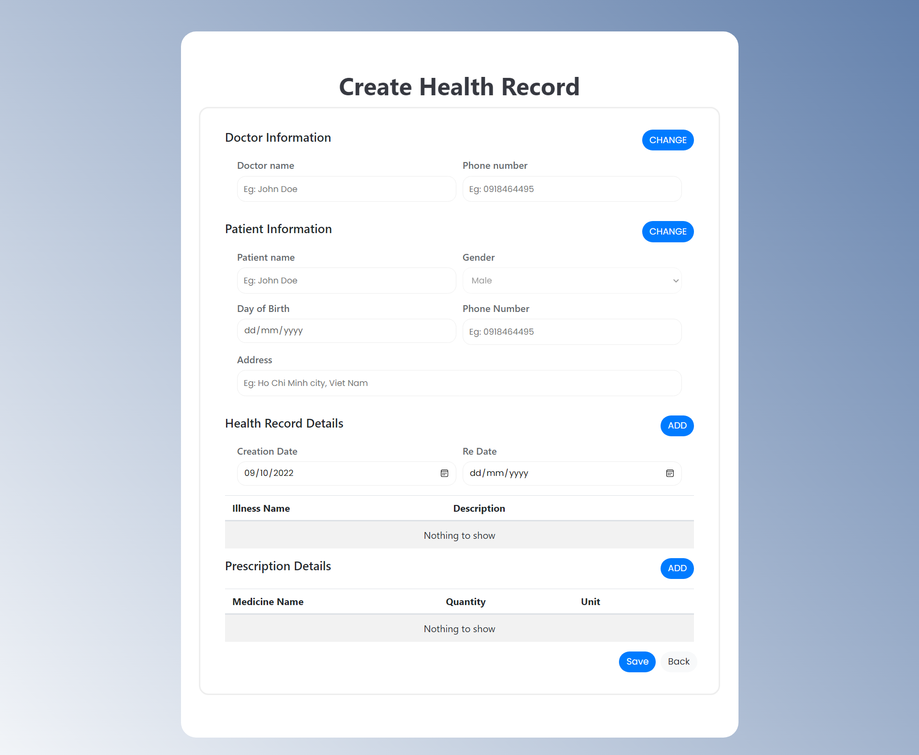
2.10.2 Create
Health
Record

Slide 47
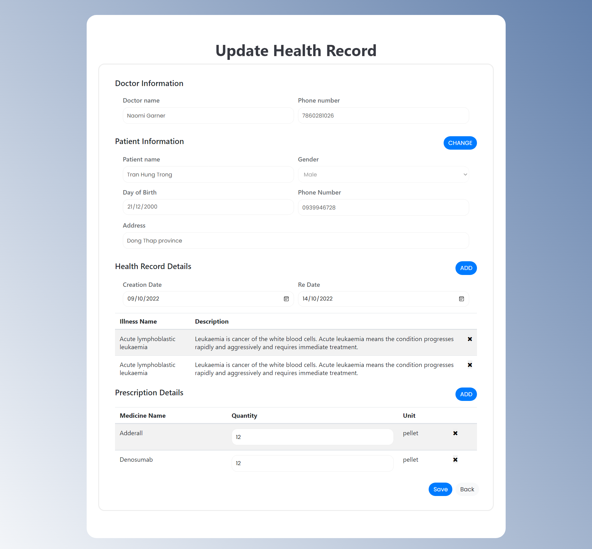
2.10.3 Update
Health
Record

Slide 48
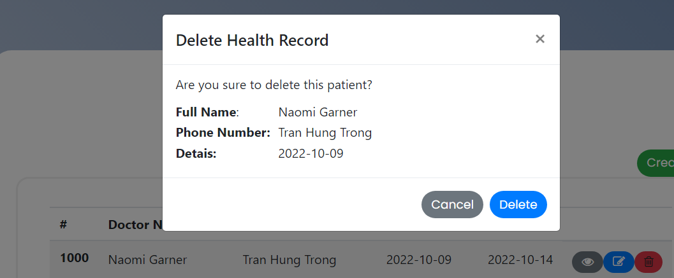
2.10.4 Delete Health Record

Slide 49
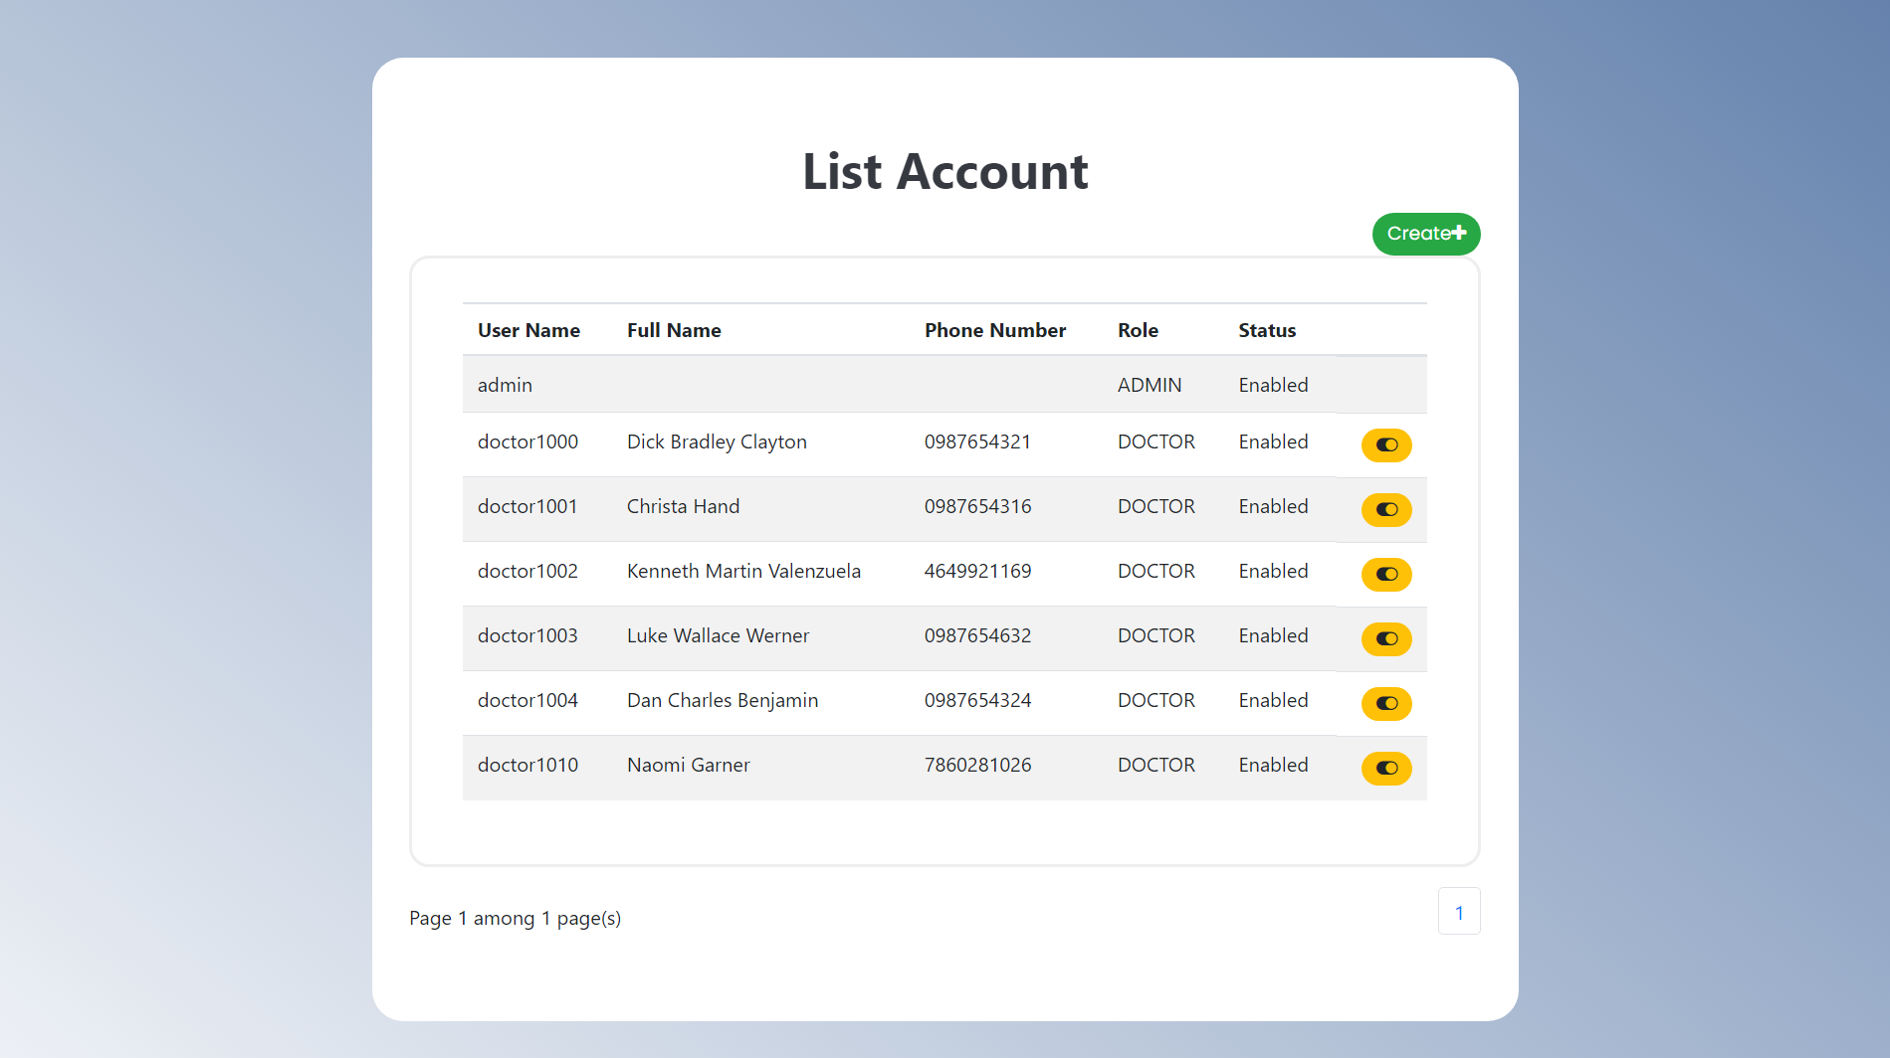
2.11.1 List Account

Slide 50
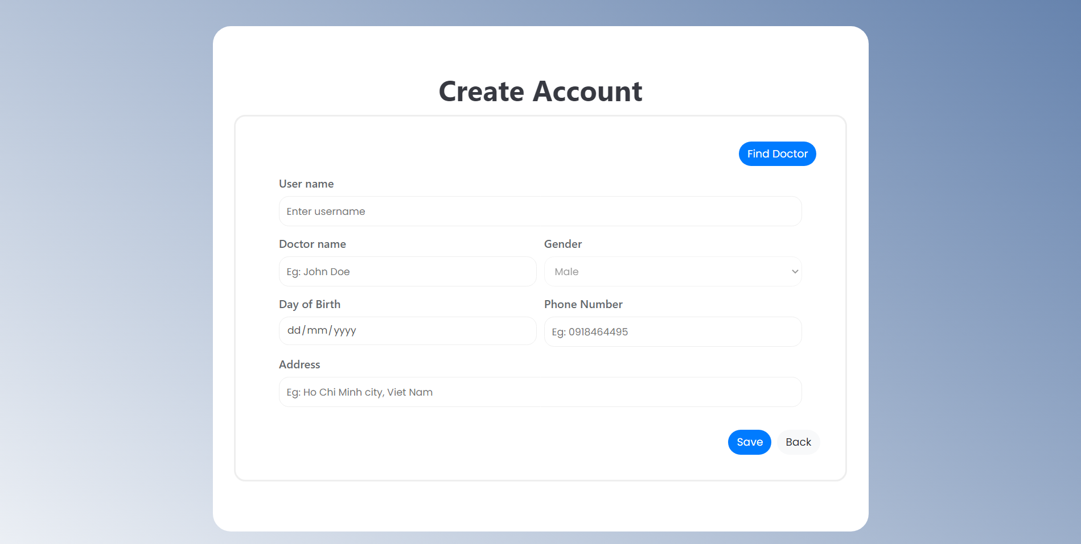
2.10.2 Create Account

Slide 51
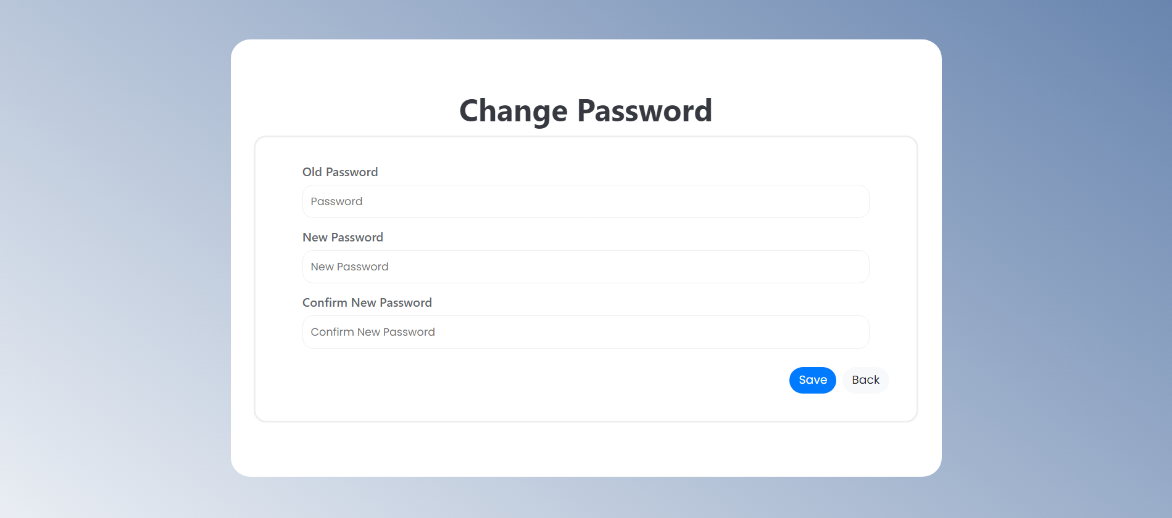
2.10.3 Change Password

Slide 52
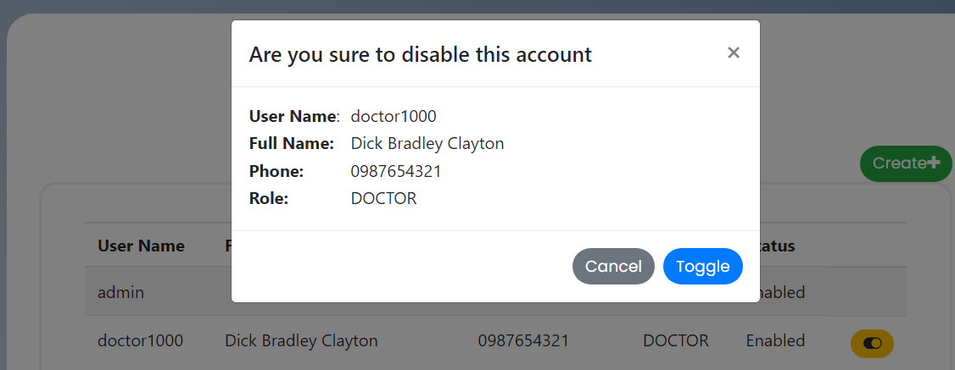
2.10.4 Disable account

Slide 53


